Slide 1
How to use Google Classroom

Slide 2
Contents
How to log in and join your class
Stream
Class work
Assignments
How to attach files and pictures to your assignment
Questions / materials / quizzes
Graded work
Class drive folder

Slide 3
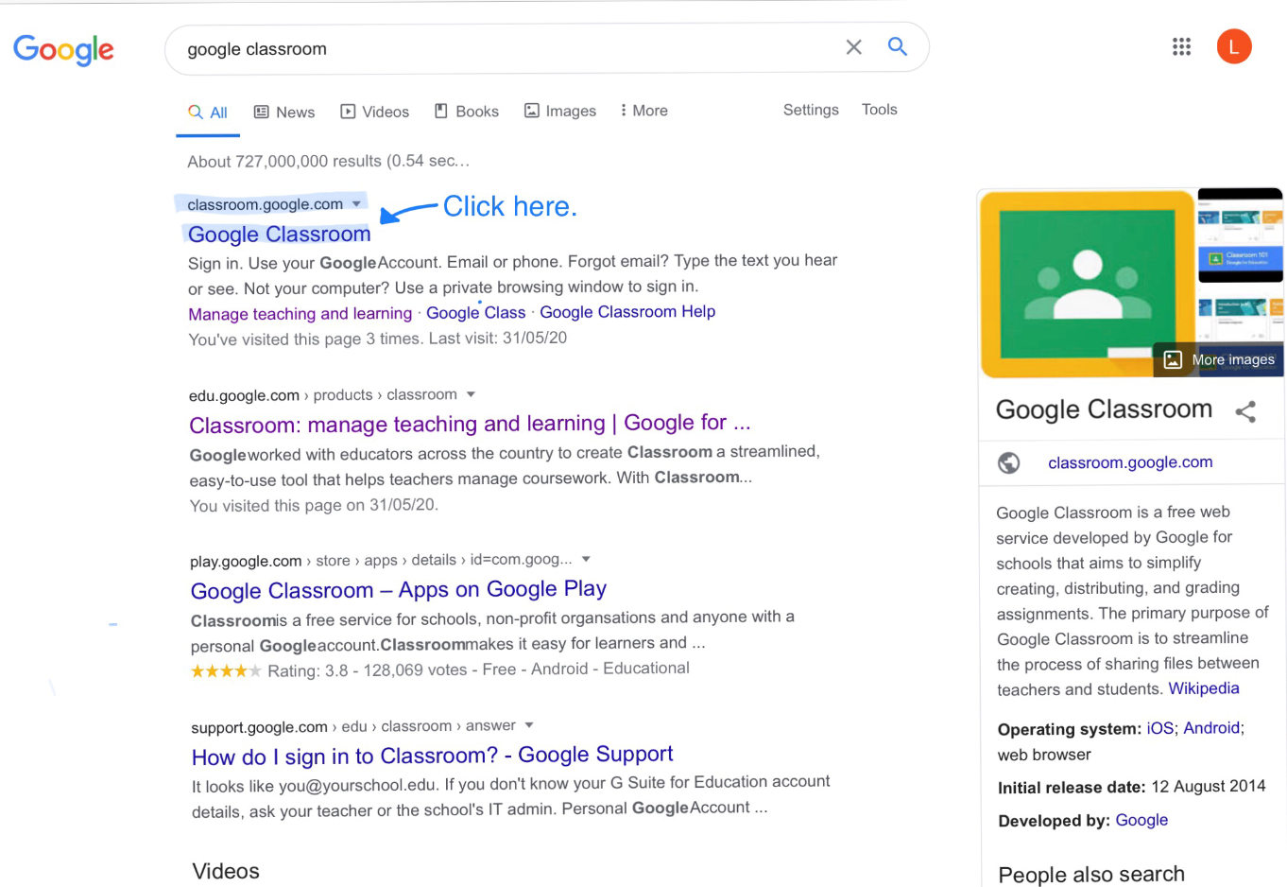
How to log in and join your class
1. Search 'Google Classroom'.

Slide 4
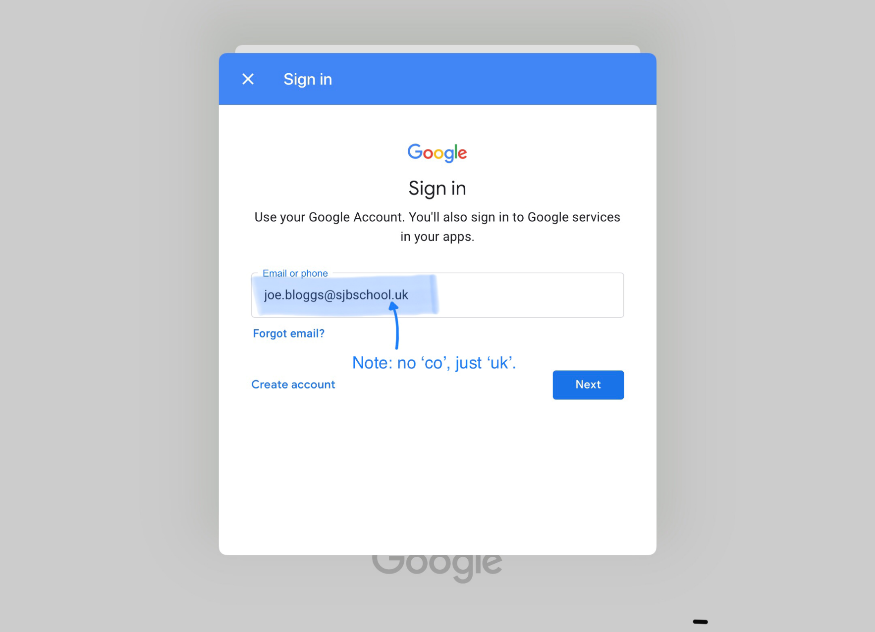
How to log in and join your class
2. Sign into your Google account.
Your username will be:
firstname.surname@sjbschool.uk
e.g. joe.bloggs@sjbschool.uk

Slide 5
How to log in and join your class
Password is
‘Pupil1234’ (case sensitive)

Slide 6
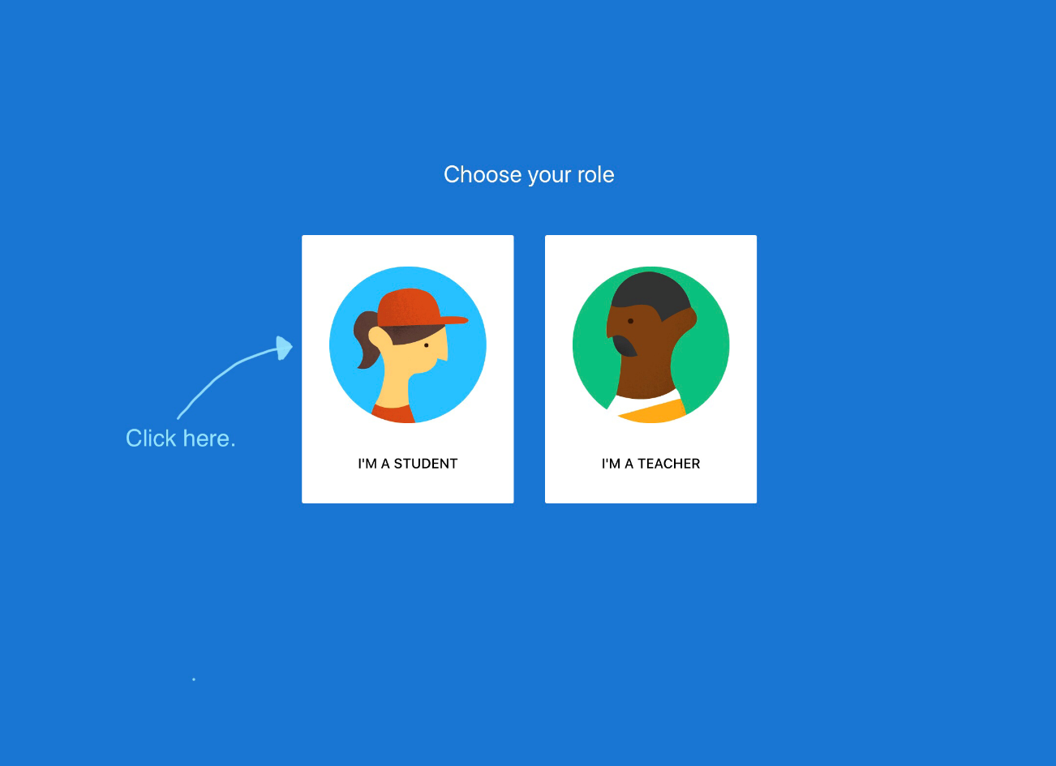
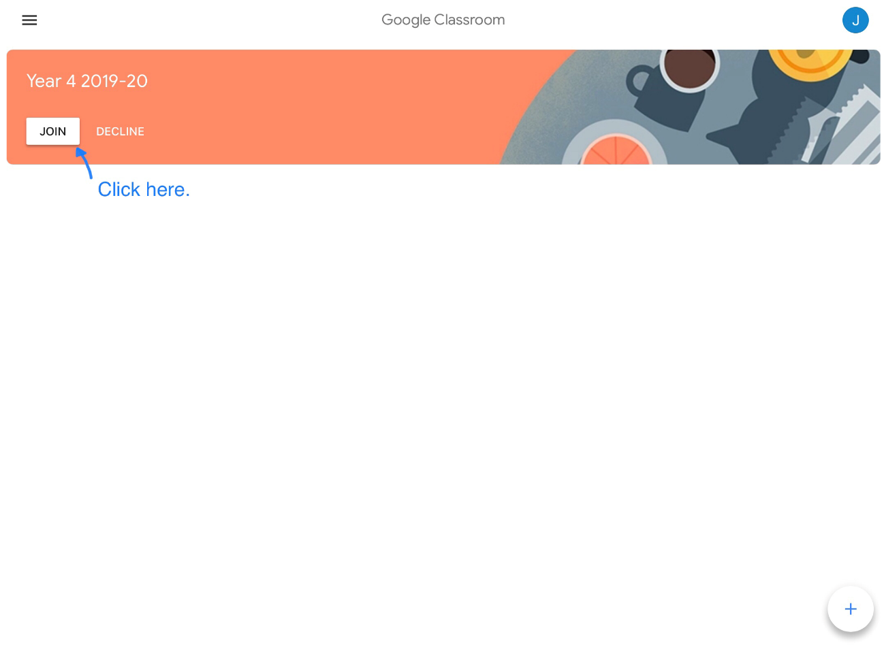
How to log in and join your class
3. Join your class.
You may see a page that looks like this:
Click on ‘I’m a student’.
Join your class!

Slide 7
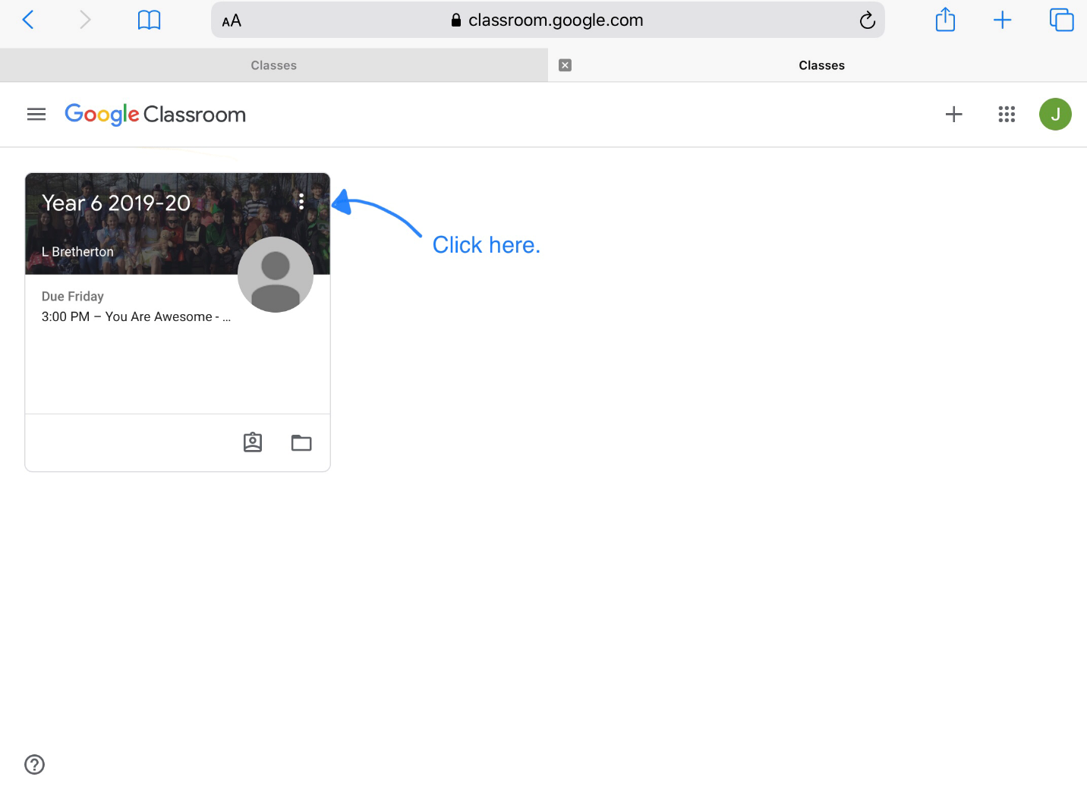
How to log in and join your class
Or you may see a page that looks like this:
Click on it and now you’re in!

Slide 8
The Stream
This is where you can see any messages, material or assignments. You can also use it to ask your teacher or classmates any questions about your work.
Please note: your messages can be seen by everyone in the class.

Slide 9
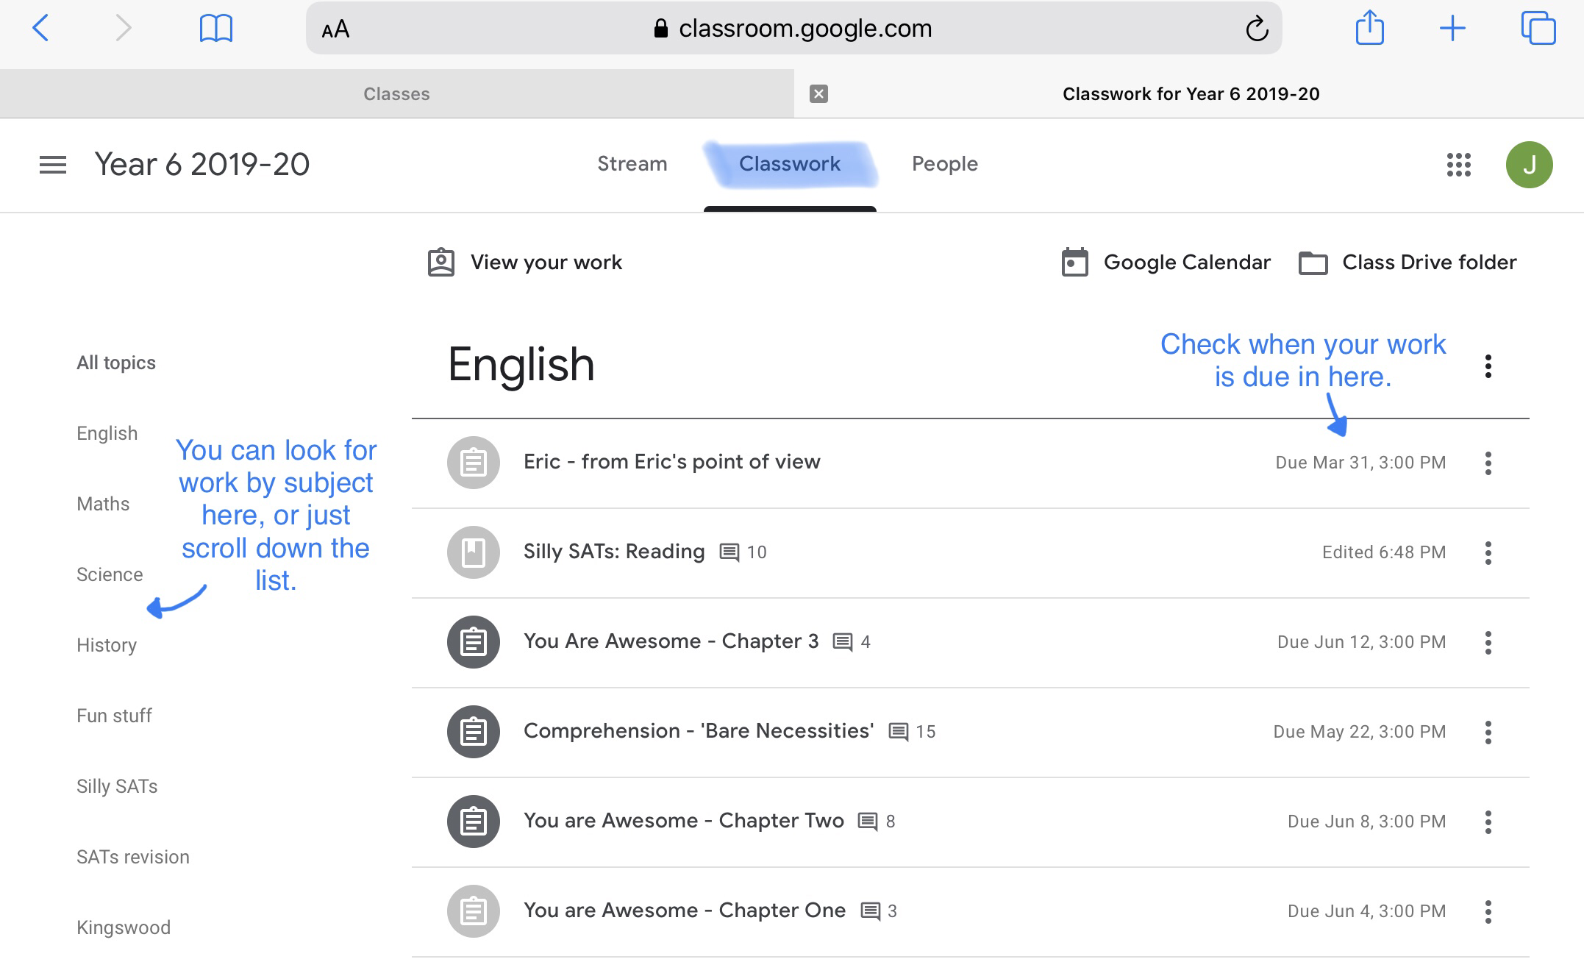
Classwork
This is where you can see all your assignments: those you have turned in, any grades left and any new work to do.

Slide 10
Assignment Page
This is where you can find all the details of your assignment:
Marks available
Due date
The document you need to submit your work on
You can attach photographs or documents to go with your assignment
You can also ask your teacher questions about the assignment; these will only be seen by your teacher.
When your assignment is complete, click ‘turn in’ and you’re done!

Slide 11
How to attach documents or pictures
Click on ‘add or create’, then click ‘file’.

Slide 12
How to attach documents or pictures
2. Add your file from your computer / device.

Slide 13
How to attach documents or pictures
3. Upload

Slide 14
How to attach documents or pictures
Done!
Click ‘turn in’.

Slide 15
Questions
If your teacher assigns you a question, it’s really easy; go into the question, type your answer and turn in!

Slide 16
Material
This is where you will find any supporting information your teacher may want you to look at.
There is no option to turn any work in here; this will be purely for your information.

Slide 17
Quiz assignment
Click on the attachment and answer the questions.
Then mark as done!

Slide 18
Quiz assignment

Slide 19
Graded work
When your work is marked, it will appear as ‘graded’.
You can check your grade and any comments your teacher has left – just click on the assignment.
If you need to make changes, you can go into your assignment and change them (your work is automatically saved).
You can then click ‘resubmit’.

Slide 20
Class Drive Folder
You can access the Class Drive folder through ‘Classwork’ on the top menu.

Slide 21
Class Drive Folder
You can store and access files to use at a later date. All of your current and previous assignments will automatically be stored in this folder; there is no need to save your work.
Your teacher can also access this folder to check the progress of your work at any time.
There may be times when your teacher may share files with you – these will be in the ‘shared with me’ folder.

Slide 22
Now you are ready to learn – wherever you may be! If you have any queries please email via admin.stjohnbosco@schools.sefton.gov.uk Stay Safe!

